Slide 1

Introduction to CUDA (7) Application: ML and CNN
Parallel Computing

Slide 2
Content
Background
Convolutional Neural Networks
Convolutional Layer: A Basic CUDA Implementation of Forward Propagation
Reduction of Convolutional Layer to Matrix Multiplication

Slide 3
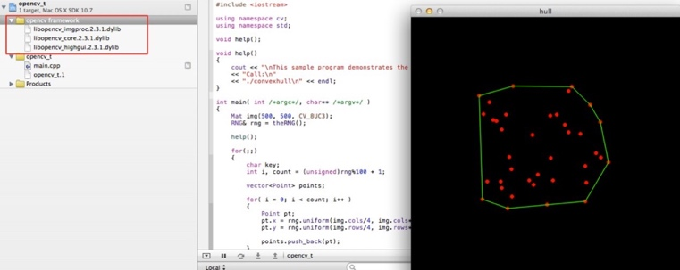
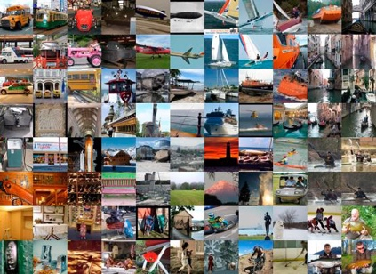
Deep Learning in Computer Vision
ImageNet
Traditional CV
Deep Learning
Traditional Computer Vision
Experts + Time
Deep Learning Object Detection
DNN + Data + HPC
Deep Learning Achieves “Superhuman” Results
Slide courtesy of Steve Oberlin, NVIDIA

Slide 4
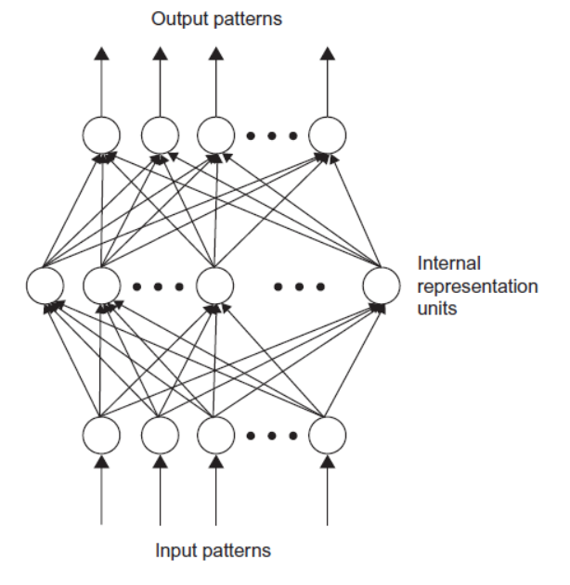
ConvNet
卷积神经网络 ConvNet ：
Easy to train
Better generalization
Multilayer
Feedforward
Network
MLP或FFN

Slide 5
ConvNet
卷积神经网络（ConvNet） 发源于1980s末期.
到20世纪90年代初，已成功应用于多个领域：
- 语音识别
- 光学字符识别
- 手写识别
- 面部识别
但数据和计算能力的不足限制了其发展.

Slide 6
ConvNet
Hinton, etc., 2006
引入了无需标记数据即可创建多层级、层次化特征检测器的无监督学习方法。
首次应用于语音识别领域。
计算机视觉中的卷积神经网络直到2012年才广为关注.
GPUs和大规模数据是驱动要素

Slide 7
Behind the Scenes
2010年University of Toronto的一门课程:
Programming Massively Parallel Programming
Prof. Andreas Moshovos
Geoffrey Hinton教授的学生参加了这门课程。
开发了深度神经网络（DNN）的GPU实现。
训练速度比CPU快了10倍以上。

Slide 8
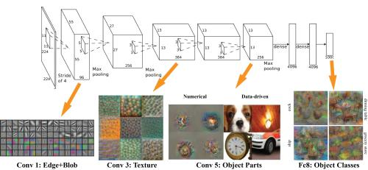
Deep ConvNet
Alex Krizhevsky, etc., 2012
AlexNet (extend the LeNet)
60 million parameters
650,000 neurons.
模型训练 :
Trained on 1.2 million images from ImageNet database.
One week on two GPUs. (GTX580, 3GB)
突破性的成果：
Error of 15.3%
Second place 26.2%

Slide 9
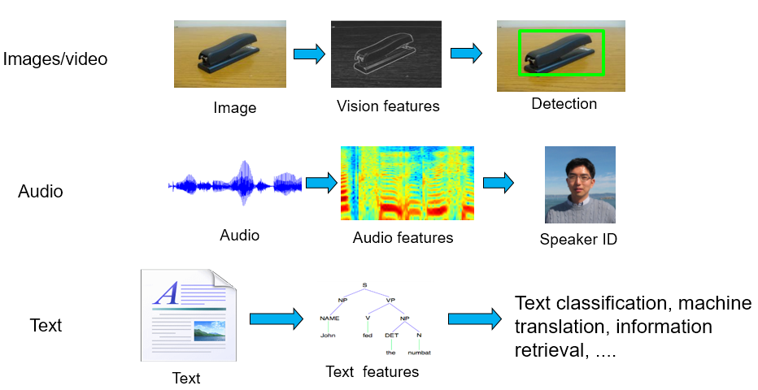
Recent Explosion of DNN
GPU 以及CUDA 大大加速了深度学习的研究周期，各个领域突飞猛进:

Slide 10
Content
Background
Convolutional Neural Networks
Convolutional Layer: A Basic CUDA Implementation of Forward Propagation
Reduction of Convolutional Layer to Matrix Multiplication

Slide 11
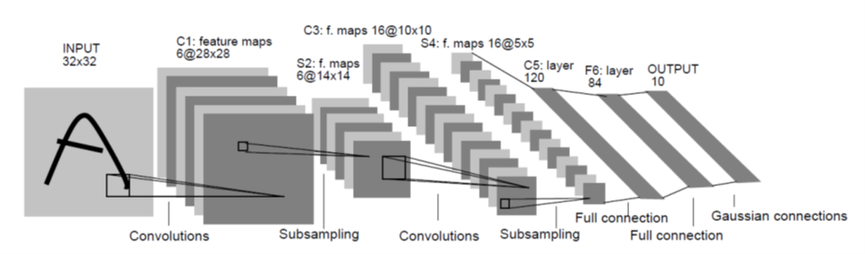
LeNet-5
Yann LeCun, 1998, 手写字符识别.
60,840 参数
340,908 连接
三种类型的层：
- 卷积层、 子采样层（也称为池化层）、 全连接层

Slide 12
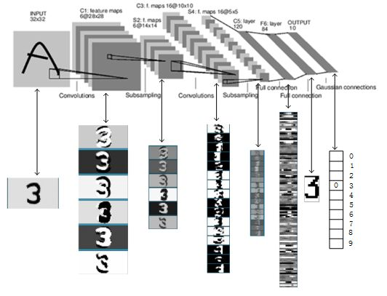
LeNet-5

Slide 13
Forward: Convolution Layer
All input feature maps contribute to all output feature maps.
One convolution mask is provided for each input-output combination.

Slide 14
Forward: Convolution Layer
C: 输入特征图数量
M: 输出特征图数量
K: 卷积核宽度
W[C, M, K, K]
X[C, H, W]
Y[M, H-K+1, W-K+1]
LeNet C1
X[C, H, W] -- X[1, 32, 32]
Y[M, H-K+1, H-K+1] -- Y[6, 28, 28]
W[C, M, K, K] -- W[1, 6, 5, 5]

Slide 15
Sequential Code for the Forward Path of a Convolution Layer
void convLayer_forward(int M, int C, int H, int W, int K, float* X, float* W, float* Y)
{
int H_out = H – K + 1;
int W_out = W – K + 1;
for(int m = 0; m < M; m++) // for each output feature map
for(int h = 0; h < H_out; h++) // for each output element
for(int w = 0; w < W_out; w++) {
Y[m, h, w] = 0;
for(int c = 0; c < C; c++) // sum over all input feature maps
for(int p = 0; p < K; p++) // KxK filter
for(int q = 0; q < K; q++)
Y[m, h, w] += X[c, h + p, w + q] * W[m, c, p, q];
}
}

Slide 16
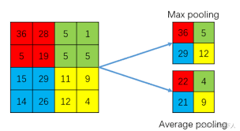
Subsampling Layer
池化层通过合并像素减少图像尺寸。
LeNet S2:
输入是6个 28 × 28的特征图（ feature maps ）
输出是6个 14 × 14的特征图
下采样合并（平均） 2 × 2 相邻像素为一个输出像素
给每个输出特征加上一个偏置值 b[m]；
非线性激活
例如双曲正切tanh、sigmoid、ReLU等函数。

Slide 17
Sequential code for the Forward Path of a Sub-sampling Layer
void poolingLayer_forward(int M, int H, int W, int K, float* Y, float* S)
{
for(int m = 0; m < M; m++) // for each output feature maps
for(int h = 0; h < H/K; h++) // for each output element
for(int w = 0; w < W/K; w++) {
S[m, x, y] = 0.;
for(int p = 0; p < K; p++) { // loop over KxK input samples
for(int q = 0; q < K; q++)
S[m, h, w] += Y[m, K*h + p, K*w + q] /(K*K);
}
// add bias and apply non-linear activation
S[m, h, w] = sigmoid(S[m, h, w] + b[m])
}
}
K=2 for LeNet S2

Slide 18
LeNet layers
C3:
16 output feature maps (10 × 10 image for each)
6 × 16 filter banks (5 × 5 weights for each)
S4:
16 output feature maps (5 × 5 image for each)
C5:
120 one-pixel output
16 × 120 = 1920 filter banks (5 × 5 weights for each)
F6:
84 output units Y6 = sigmoid (W*X + b)
fully connected from C5
Final Output
10 elements generated from Gaussian filters
Compute loss function

Slide 19
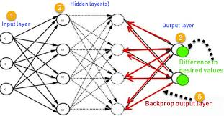
Back-Propagation
ConvNets training:
有标签数据获得误差 error
定义损失函数 Loss function
误差反向传播，梯度下降优化，gradient backpropagation

Slide 20
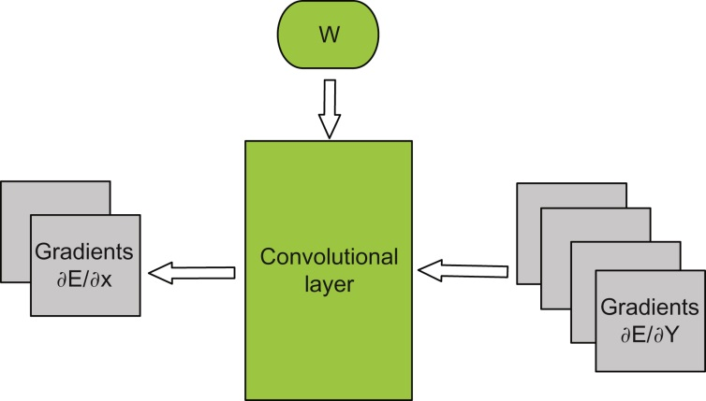
Back-Propagation of ∂E/∂X
Each layer receives as its input ∂E/∂Y
—gradient with respect to its output feature maps
and calculates ∂E/∂X
— gradient with respect to its input feature maps

Slide 21
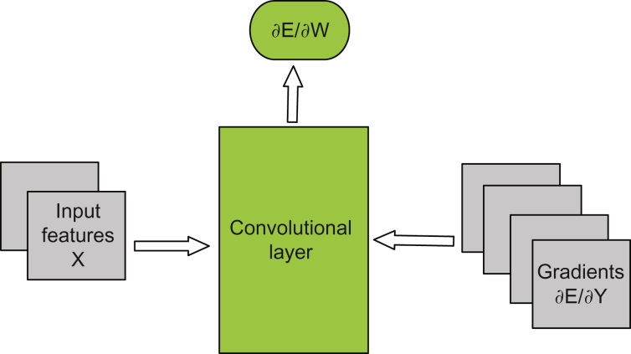
Back-Propagation of ∂E/∂W
If a layer has learned parameters (“weights”) W,
then it also calculates ∂E/∂W
—gradient of loss with respect to weights

Slide 22


Back-Propagation
For the fully connected layer is given as:
The backpropagation of gradient ∂E/∂Y is expressed by two equations:
Y = W*X

Slide 23

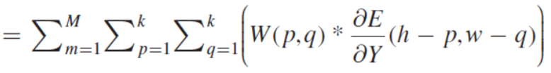
Calculation of ∂E/∂X
The gradient ∂E/∂X：
with respect to the channel c of input X is given as
sum of “backward convolution” with corresponding W^{T}(c,m) over all layer outputs m:

Slide 24
Calculation of ∂E/∂X
void convLayer_backward_xgrad(int M, int C, int H_in, int W_in, int K,
float* dE_dY, float* W, float* dE_dX) {
int m, c, h, w, p, q;
int H_out = H_in – K + 1;
int W_out = W_in – K + 1;
for(c = 0; c < C; c++)
for(h = 0; h < H_in; h++)
for(w = 0; w < W_in; w++)
dE_dX[c, h, w] = 0.;
for(m = 0; m < M; m++)
for(h = 0; h < H_out; h++)
for(w = 0; w < W_out; w++)
for(c = 0; c < C; c++)
for(p = 0; p < K; p++)
for(q = 0; q < K; q++)
dE_dX[c, h + p, w + q] += dE_dY[m, h, w] * W[m, c, p, q];
}
assumes ∂E/∂Y has been calculated; dE_dX has been allocated in device.

Slide 25


Calculation of ∂E/∂W
The gradient ∂E/∂W：
Since each W(c,m) affects all elements of the output Y(m),
we accumulate gradients over all pixels in the corresponding output feature map:

Slide 26
Calculation of ∂E/∂W
void convLayer_backward_wgrad(int M, int C, int H, int W, int K,
float* dE_dY, float* X, float* dE_dW) {
int m, c, h, w, p, q;
int H_out = H – K + 1;
int W_out = W – K + 1;
for(m = 0; m < M; m++)
for(c = 0; c < C; c++)
for(p = 0; p < K; p++)
for(q = 0; q < K; q++)
dE_dW[m, c, p, q] = 0.;
for(m = 0; m < M; m++)
for(h = 0; h < H_out; h++)
for(w = 0; w < W_out; w++)
for(c = 0; c < C; c++)
for(p = 0; p < K; p++)
for(q = 0; q < K; q++)
dE_dW[m, c, p, q] += X[c, h + p, w + q] * dE_dY[m, c, h, w];
}
assumes ∂E/∂Y has been calculated; dE_dW has been allocated in device.
W(t+1) = W(t)−λ* ∂E/∂W

Slide 27
Stochastic Gradient Descent
训练：
训练数据集通常很大。
不是对整个训练数据集进行前向-后向传播：
而是随机选择一个小的子集(“mini-batch”) N张图像；
仅对这个子集计算梯度；
然后选择另一个子集，依此类推。
这个过程增加了一个额外的维度 n
—— 即小批量中样本的索引。mini-batch

Slide 28
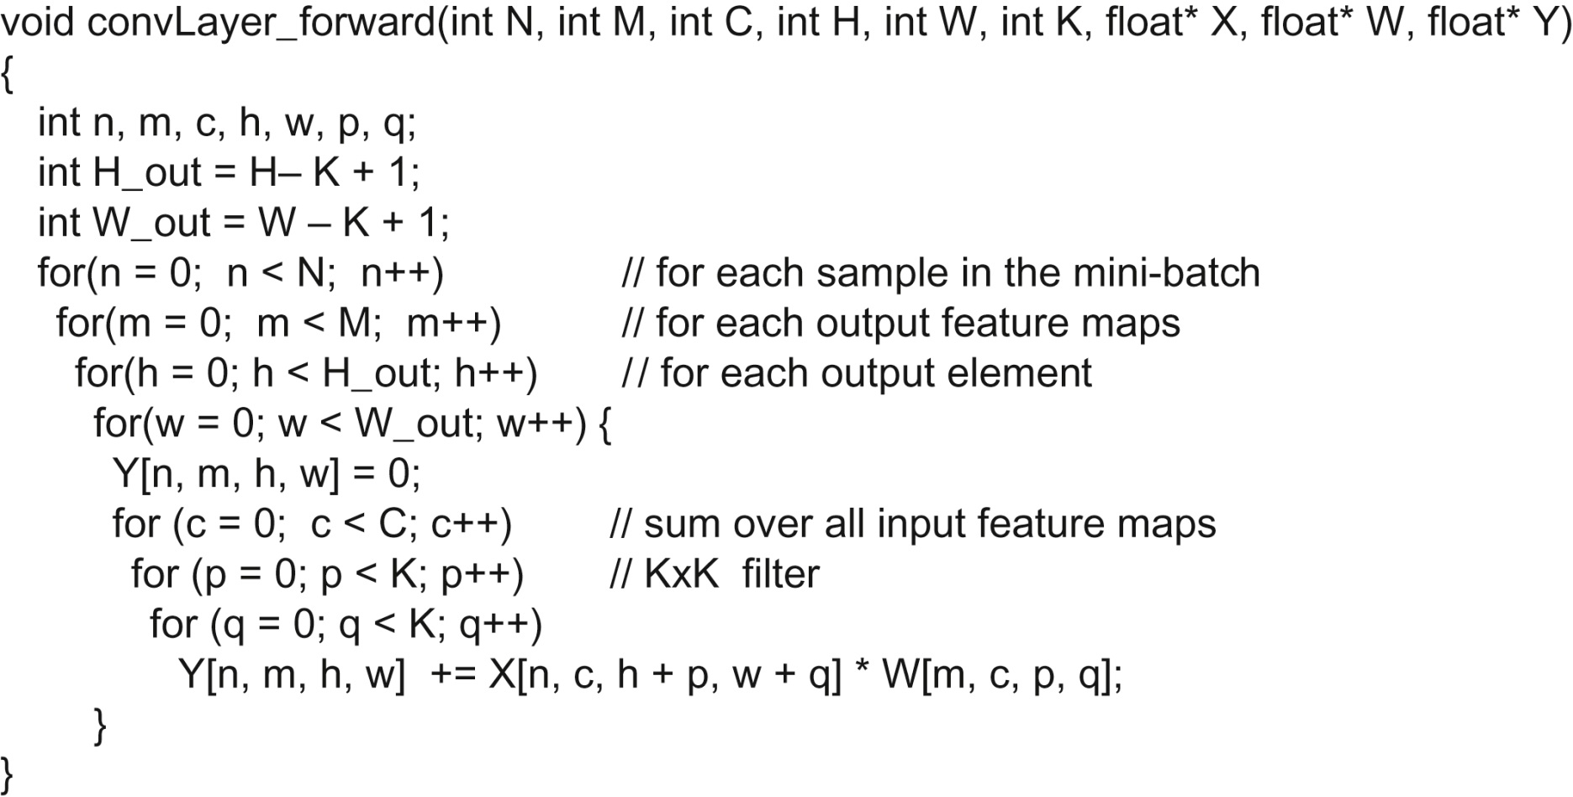
Training with mini-batch

Slide 29
Content
Background
Convolutional Neural Networks
Convolutional Layer: A Basic CUDA Implementation of Forward Propagation
Reduction of Convolutional Layer to Matrix Multiplication

Slide 30
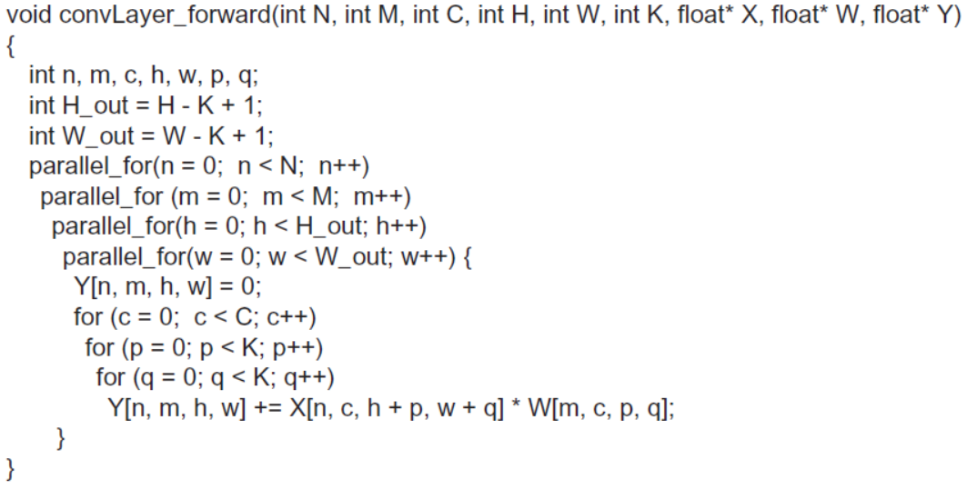
Parallel forward path
N*M*H_out*W_out
Different parallel samples in a mini-batch, different output feature maps for the same sample, and different elements for each output feature map. In Parallel.

Slide 31
Parallel forward path
Threads Organization:
假设每个线程将计算一个输出特征图中的一个元素。
使用二维线程块，每个块对应一个 (TILE_WIDTH x TILE_WIDTH) 元素的瓦片.
e.g. TILE_WIDTH=16, then 256 threads per block.
Blocks are organized into a 3D grid:
1. 网格的第一个维度（X）对应于批量中的样本（N）；
2. 第二个维度（Y）对应于（M）输出特征图；
3. 最后一个维度（Z）定义在输出特征图的位置。

Slide 32
Parallel forward path
方便起见，定义H_out (height of the output image) 和 W_out (width of the output image) 是TILE_WIDTH的整倍数 (set to 16 below):
# define TILE_WIDTH 16
// number of horizontal tiles per output map
W_grid = W_out/TILE_WIDTH;
// number of vertical tiles per output map
H_grid = H_out/TILE_WIDTH;
Z = H_grid * W_grid;
dim3 blockDim(TILE_WIDTH, TILE_WIDTH, 1);
dim3 gridDim(N, M, Z);
ConvLayerForward_Kernel<<< gridDim, blockDim>>>(…);

Slide 33
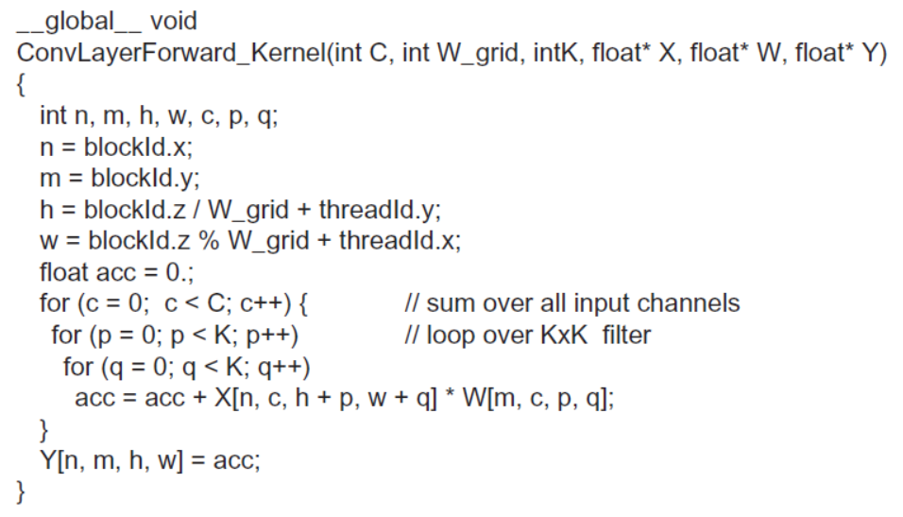
Parallel forward path -- Kernel
High degree of parallelism;
but excessive global memory bandwidth.
？
pseudo-code

Slide 34
Parallel forward -- improvement
use shared memory tiling:
1. 将卷积核W[m,c] 加载到共享内存中.
2. 所有线程协作将输入 X[n,c,..,..] 中需要计算输出tile的部分复制到共享内存数组 X_shared​ 中.
3. 计算输出(部分)加和Y_shared[n, m,.,.].
4. 移动到下一个输入通道 c.
shared memory allocation:
输入 X_tile_width * X_tile_width
X_tile_width = TILE_WIDTH + K-1.
K*K 个卷积核系数.

Slide 35
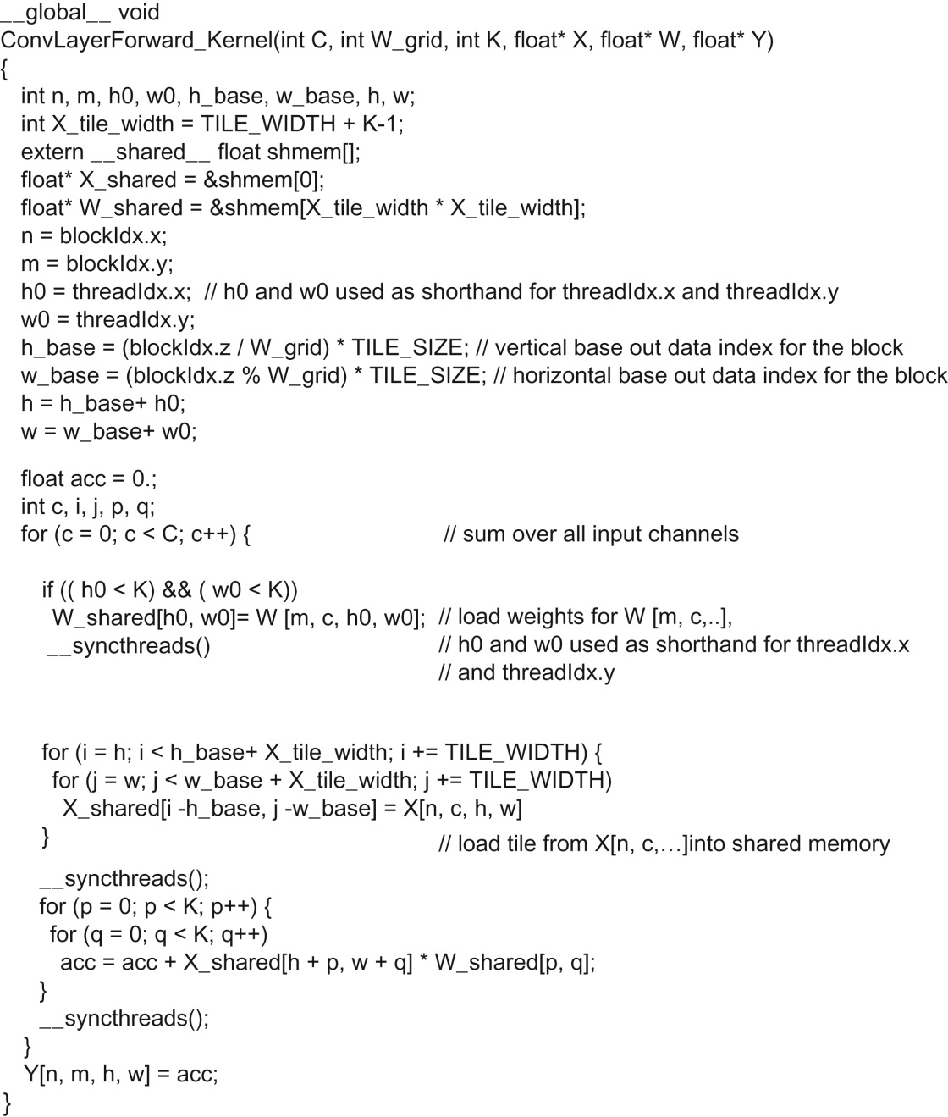
Kernel using shared memory

Slide 36
Content
Background
Convolutional Neural Networks
Convolutional Layer: A Basic CUDA Implementation of Forward Propagation
Reduction of Convolutional Layer to Matrix Multiplication

Slide 37
GEMM
Build an even faster convolutional layer:
将卷积转换为更高效的矩阵乘法运算;
GEneral Matrix to Matrix Multiplication (GEMM)
from CUDA linear algebra library (cuBLAS).
Introduced in 2006 by CPS.
Main idea:
将输入展开并复制（ unfolding and replicating ），
并将计算一个输出元素所需的所有元素都存储为一个连续的块（ sequential block ）.
将卷积层的前向运算简化为一个大矩阵-矩阵乘法。
https://petewarden.com/2015/04/20/why-gemm-is-at-the-heart-of-deep-learning/

Slide 38
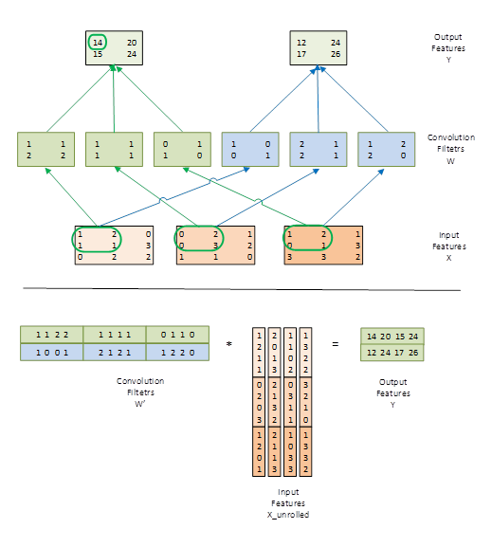
Example of the Forward Path of a Convolution Layer
M=2
7
5
2
2*3=6
1*0+ 1*2 +
1*0 + 1*3
1*0+ 1*2 +
1*0 + 1*3
1*1+ 1*2 +
2*1 + 2*1
C=3

Slide 39
GEMM-example
输入矩阵元素的重排列:
由于卷积是在输入特征图上滑动并计算加权求和，因此可以将输入特征拼接成一个大矩阵；
这个矩阵的每一行都包含了计算一个输出特征元素所需的所有输入值.
这个过程意味着每个输入元素将会被复制多次：
In example 4*1 + 2*4 + 1*4 = 16.

Slide 40
Size of the unrolled input matrix
高度 height:
计算输出特征图中的每一个元素所需要的的输入特征图中的元素数目
C*K*K
宽度 width:
输出特征图中的元素数目
H_out*W_out
扩展比率 ratio:
(K*K*H_out*W_out)/(H_in*W_in) -- > K*K

Slide 41
Size of the unrolled filter-bank matrix
高度 height:
输出特征图的数目(M).
宽度 width:
计算一个输出特征元素所需的卷积核系数数目
C*K*K
扩展比率 ratio:
no duplication occurs

Slide 43
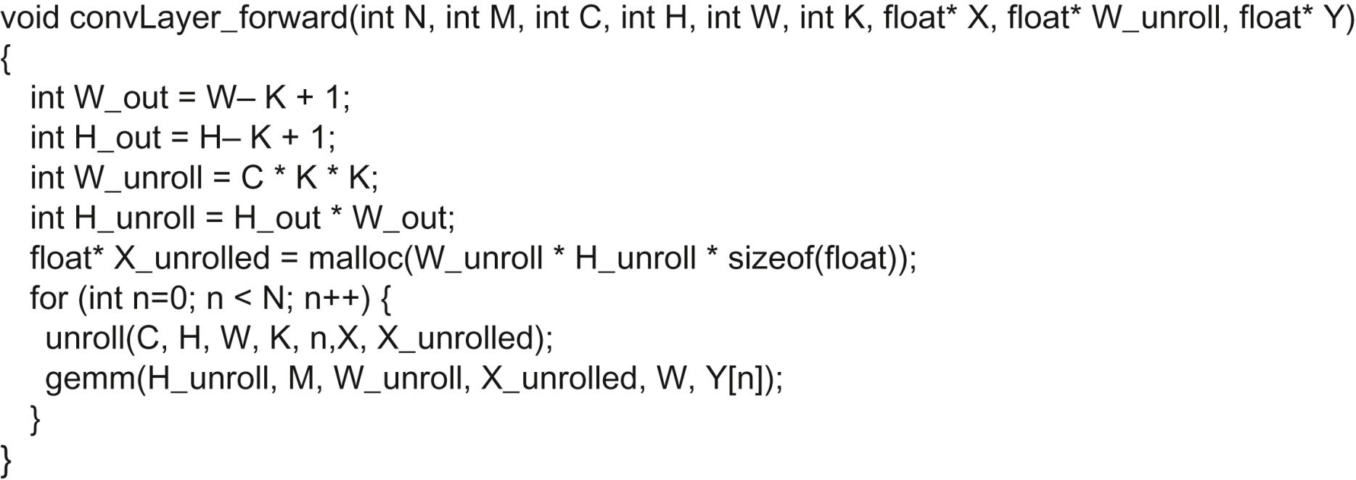
CUDA Implementation
使用矩阵乘法实现卷积层前向路径的串行版本.

Slide 44
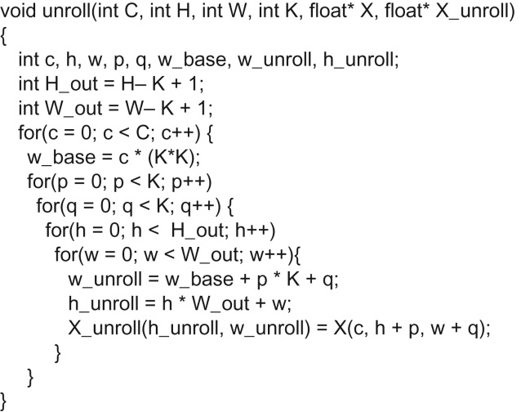
CUDA Implementation
将输入矩阵展开得到 X_unroll array.

Slide 45
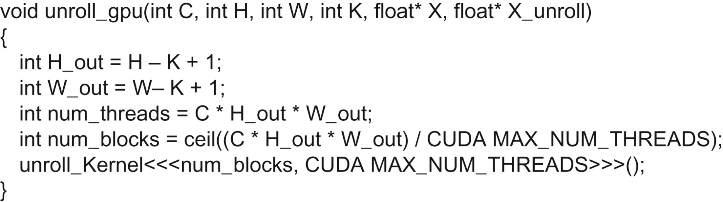
CUDA Implementation
Host code for invoking the unroll kernel.

Slide 46
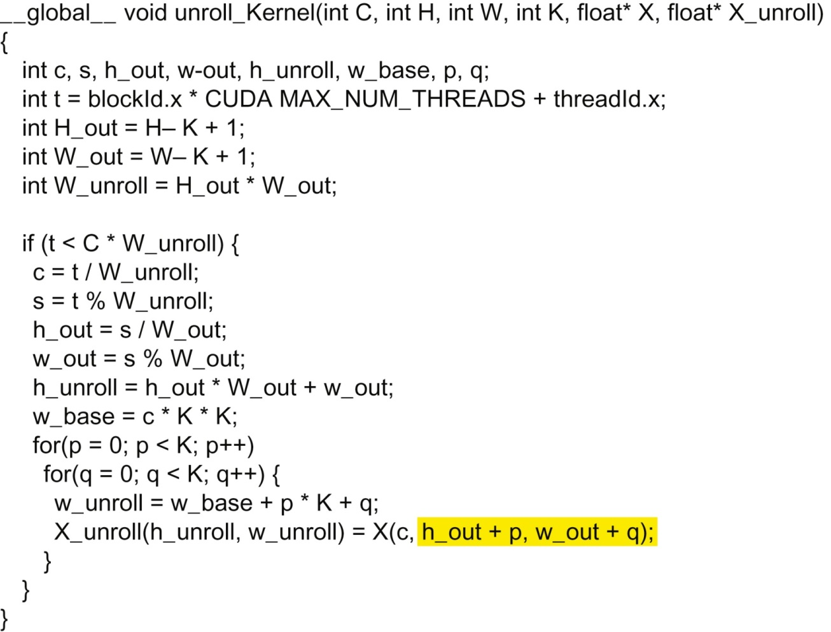
CUDA Implementation

Slide 47
Some Observations
只要所有输出特征图的像素总数很大，那么并行度就相当高：
这与卷积神经网络（CNN）架构非常匹配。
C*H_out*W_out 通常相当大
每个输入tile被多次加载
once for each block that calculates the output tile that requires the input tile
全局内存带宽不够高效

Slide 48
CuDNN
C语言实现的深度学习基础函数API :
输入数据：D is a four-dimensional N x C x H x W tensor;
卷积核：F is a four-dimensional K x C x R x S tensor;
cuDNN 支持多种卷积网络的计算:
matrix multiplication-based(GEMM & Winograd)
fast-Fourier transform-based

Slide 49
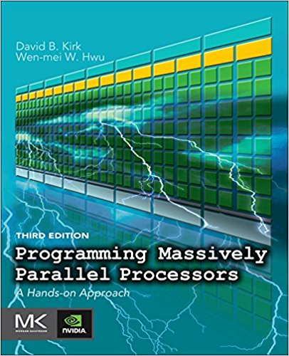
Reference
CUDA C Programming Guide,
https://docs.nvidia.com/cuda/cuda-c-programming-guide/index.html
Programming Massively Parallel Processors,
A Hands-on Approach
Third Edition
Chapter 16

